Slide 1
Lecture 15
CSCI 2270 Summer 2018
July 9, 2018

Slide 2
Outline
Vectors
Graphs
Start the Lecture Quiz a bit early
For anyone who’s interested:
What: CS Theory Seminar: Quantum Supremacy and Its Applications
When: Wed July 11 @ 3pm
Who: Scott Aaronson (University of Texas at Austin)
Where: ECCR 110 (may change)

Slide 3
Vectors
Think “dynamic arrays” with automatic resizing
#include <vector> //calls vector library
vector <int> vec; //declare a vector: need the word vector, followed by <type>
vec.push_back(2); //adds the number 2 to the end of the vector
vec.pop_back(); //remove the last element from the vector

Slide 4
Trying it out
We driving

Slide 5
Graphs
Directed vs undirected
Weighted vs unweighted
Representations: Adjacency List vs Adjacency Matrix
Simple graph: An undirected, unweighted graph without self-loops

Slide 6
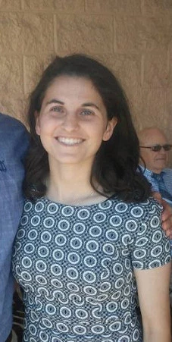
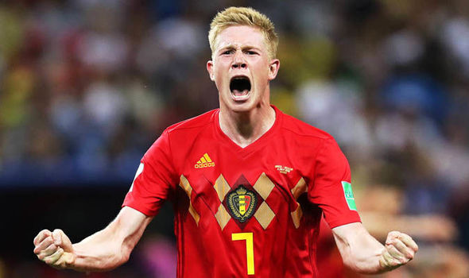
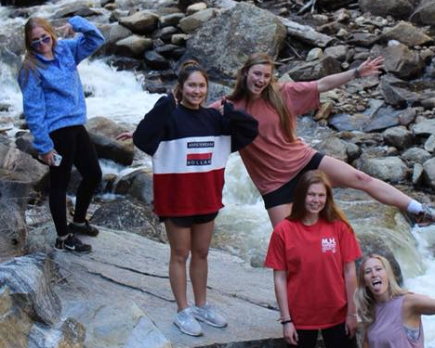
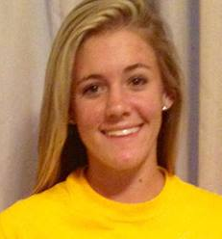
Graphs: Directed vs Undirected
Directed: I follow Kevin De Bruyne on Twitter, but he doesn’t follow me back
Undirected: People I have played on a soccer team with

Slide 7
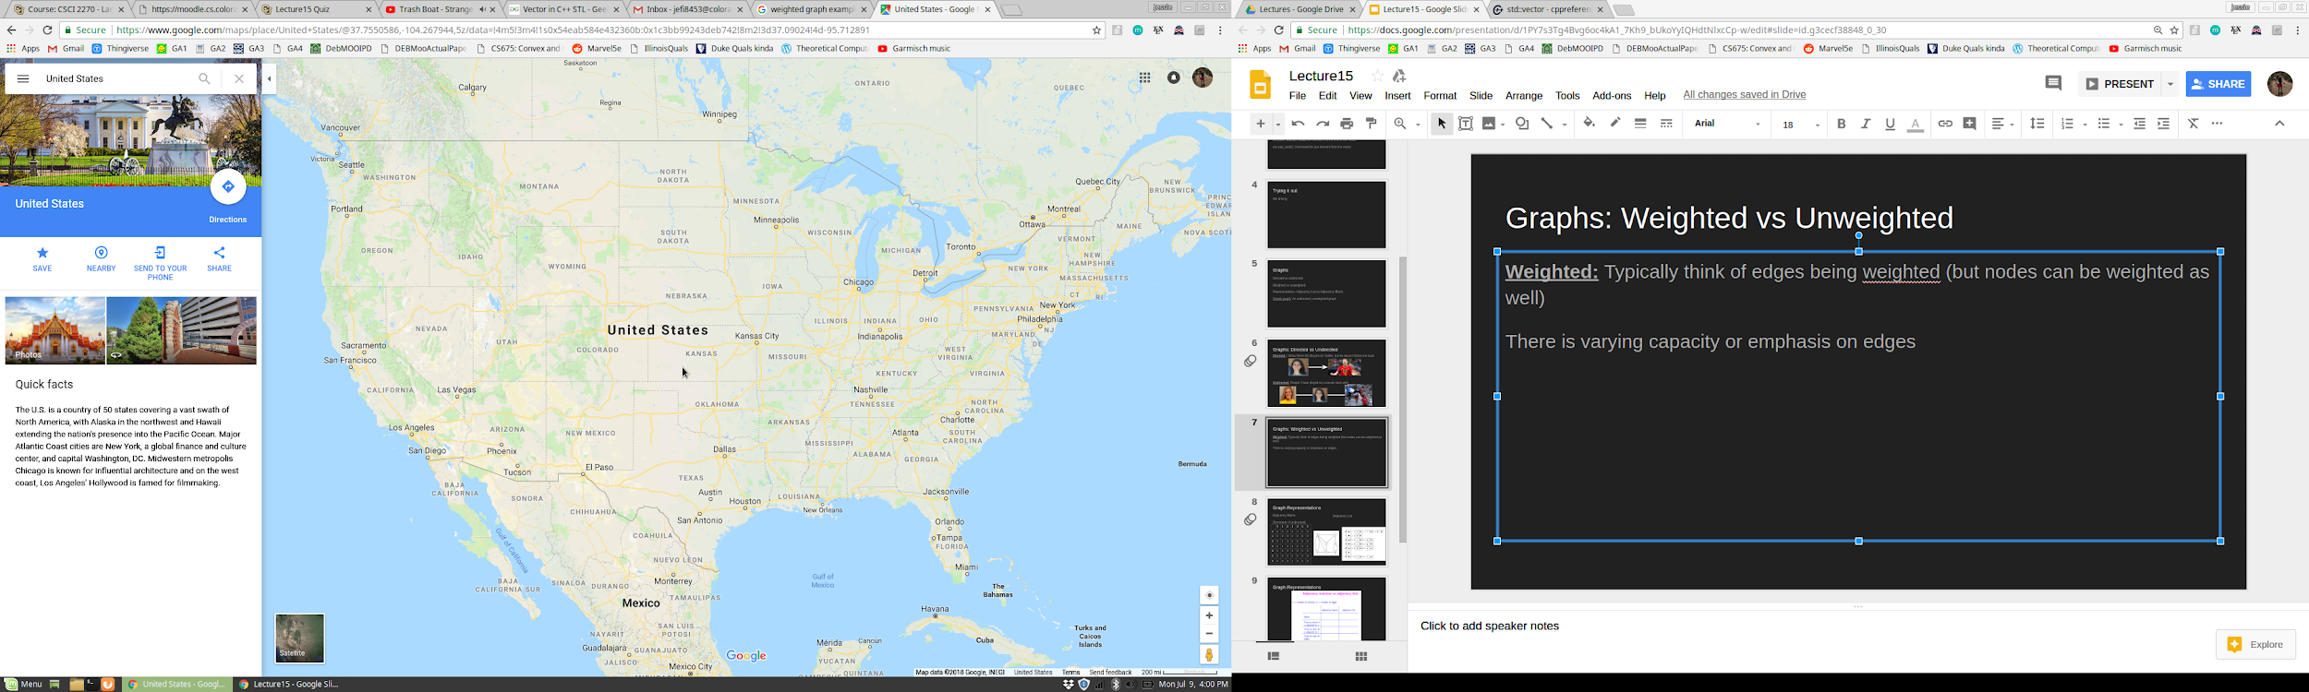
Graphs: Weighted vs Unweighted
Weighted: Typically think of edges being weighted (but nodes can be weighted as well)
There is varying capacity or emphasis on edges
1200
1000
2400
800
2000
Weighted Graph Example

Slide 8
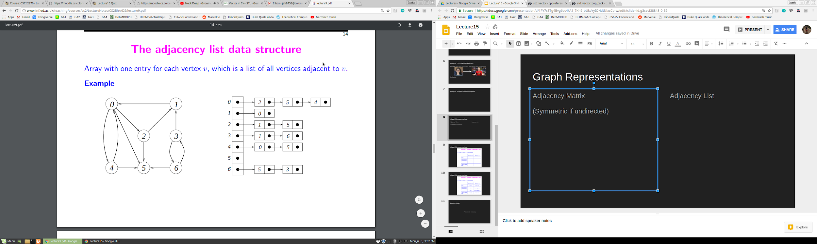
Graph Representations
Adjacency Matrix
(Symmetric if undirected)
Adjacency List
 | 0 | 1 | 2 | 3 | 4 | 5 | 6
0 | 0 | 0 | 1 | 0 | 1 | 1 | 0
1 | 1 | 0 | 0 | 0 | 0 | 0 | 0
2 | 0 | 1 | 0 | 0 | 0 | 1 | 0
3 | 0 | 1 | 0 | 0 | 0 | 0 | 1
4 | 1 | 0 | 0 | 0 | 0 | 1 | 0
5 | 0 | 0 | 0 | 0 | 0 | 0 | 0
6 | 0 | 0 | 0 | 1 | 0 | 1 | 0

Slide 9
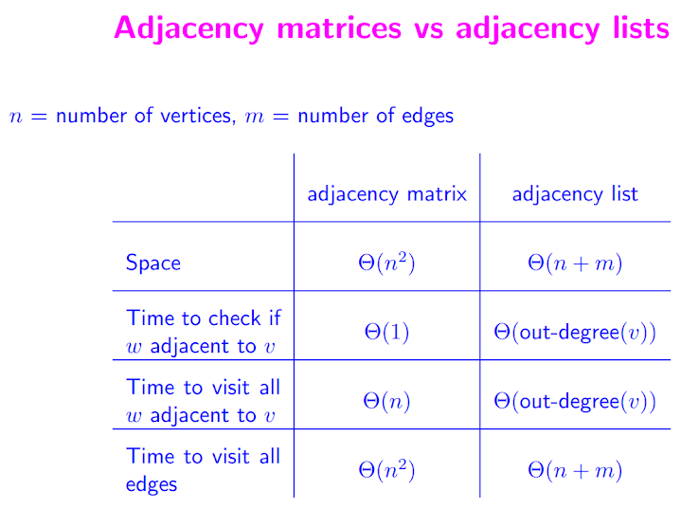
Graph Representations

Slide 10
Graph Representations

Slide 11
Lecture Quiz
Password: monday

